Slide 1
Taming the JavaScript Dragon with TypeScript
Dustin Ewers
Consultant @ Centare
Website: www.dustinewers.com
LinkedIn: www.linkedin.com/in/dustinewers
Demo Code: https://github.com/DustinEwers/typescript-demos

Slide 2
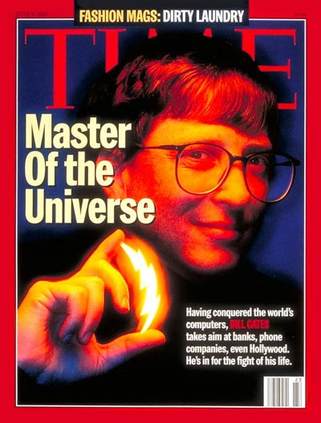
1995
Notes:
1995 had lots of major cultural achievements
Gates = sith lord

Slide 3

1995
Notes:
First computer rendered movie. Took a room of computers, but now could be done on my watch.

Slide 4

1995
Notes:
… and Gangsters Paradice

Slide 5

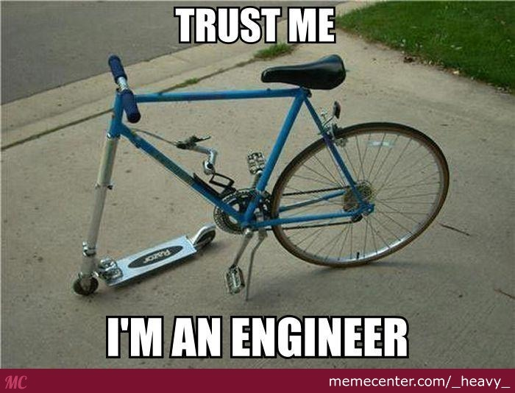
JavaScript: A History Lesson
Notes:
Brendan Eich
10 days
Standardized in 1996
Purpose: Add dynamic elements to web pages

Slide 6
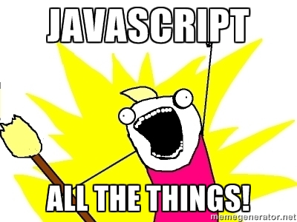
Microcontrollers: Johnny-Five
Servers: Node.js
Command line tools: npm, gulp, etc...
Data Storage and Transport: JSON
Mobile Apps: Cordova, Ionic
Desktop applications: Electron

Slide 7
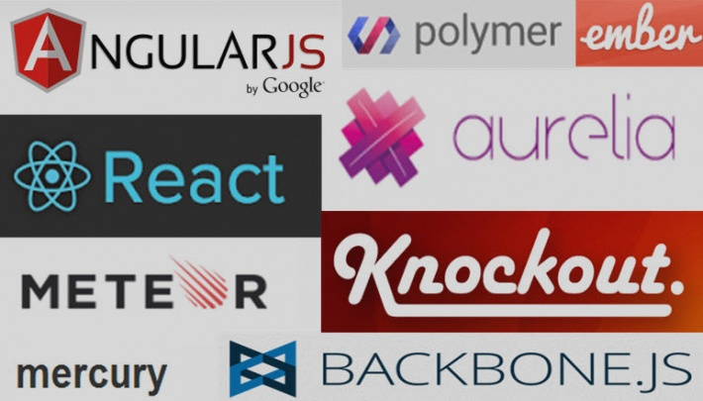

Slide 8


Slide 9
that’s cool, but…

Slide 10


Slide 11
JavaScript: The Lousy Parts
Weird Inheritance
No Modules
Dynamically Typed
Poor choice of Number type
Horrendous Scoping

Slide 12
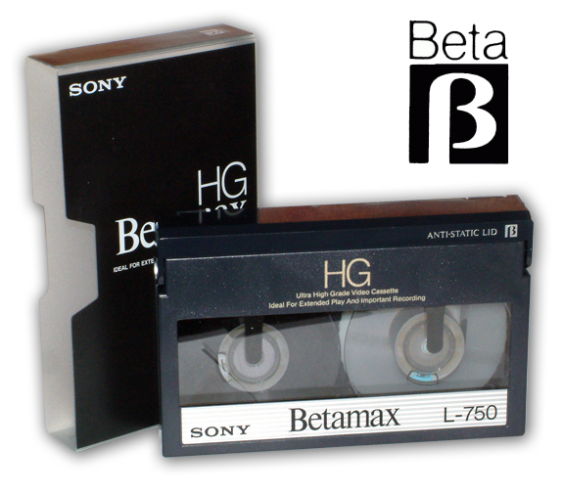
JavaScript == VHS

Slide 13
So why are we using JavaScript?
Runs everywhere
Smart People
Amazing Frameworks

Slide 14
Escaping The Fail
ES2015, ES2016
Compile Another Language Into JavaScript

Slide 15
ECMAScript 2015 / ES6
Classes, modules, and scoped variables
Tasty Syntactic Sugar like arrow function and string interpolation
Transpilation (Babel, Traceur)

Slide 16
JavaScript as the New Assembler
There are over 200 different JavaScript compilers.
Popular ones include CoffeeScript and Dart
Other compilers exist for C#, Java, Ruby, etc…
Notes:
https://github.com/jashkenas/coffeescript/wiki/List-of-languages-that-compile-to-JS

Slide 17
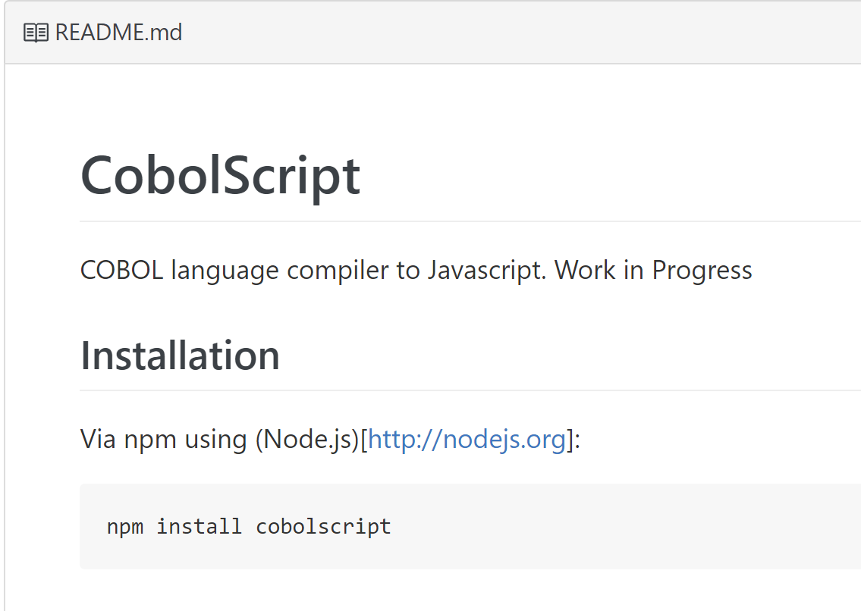
Notes:
https://github.com/ajlopez/CobolScript

Slide 18
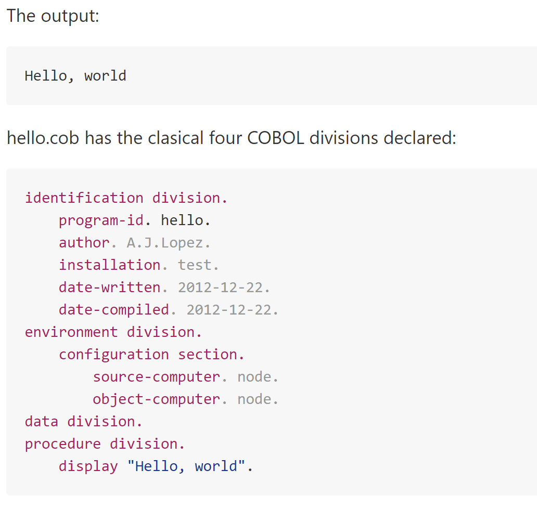

Slide 19
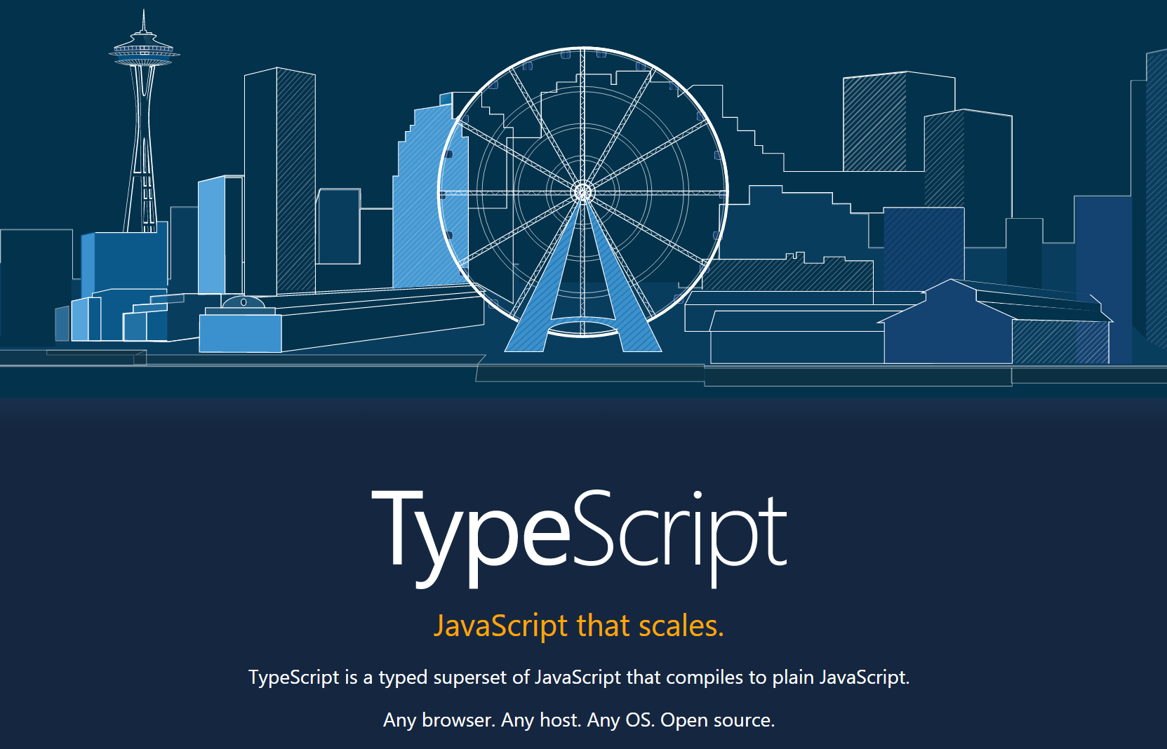
Notes:
https://www.typescriptlang.org/
Kinda in the middle
Superset of JS
ES6/ES7 Features
Optional Static Typing

Slide 20
TypeScript: A brief history
Invented by Microsoft
Released in 2012 (after two years, not 10 days)
Typescript 2.0 is the most recent release

Slide 21
Why TypeScript?
It mitigates JavaScript’s primary weakness

Slide 22

Why TypeScript? - Static Typing

Slide 23
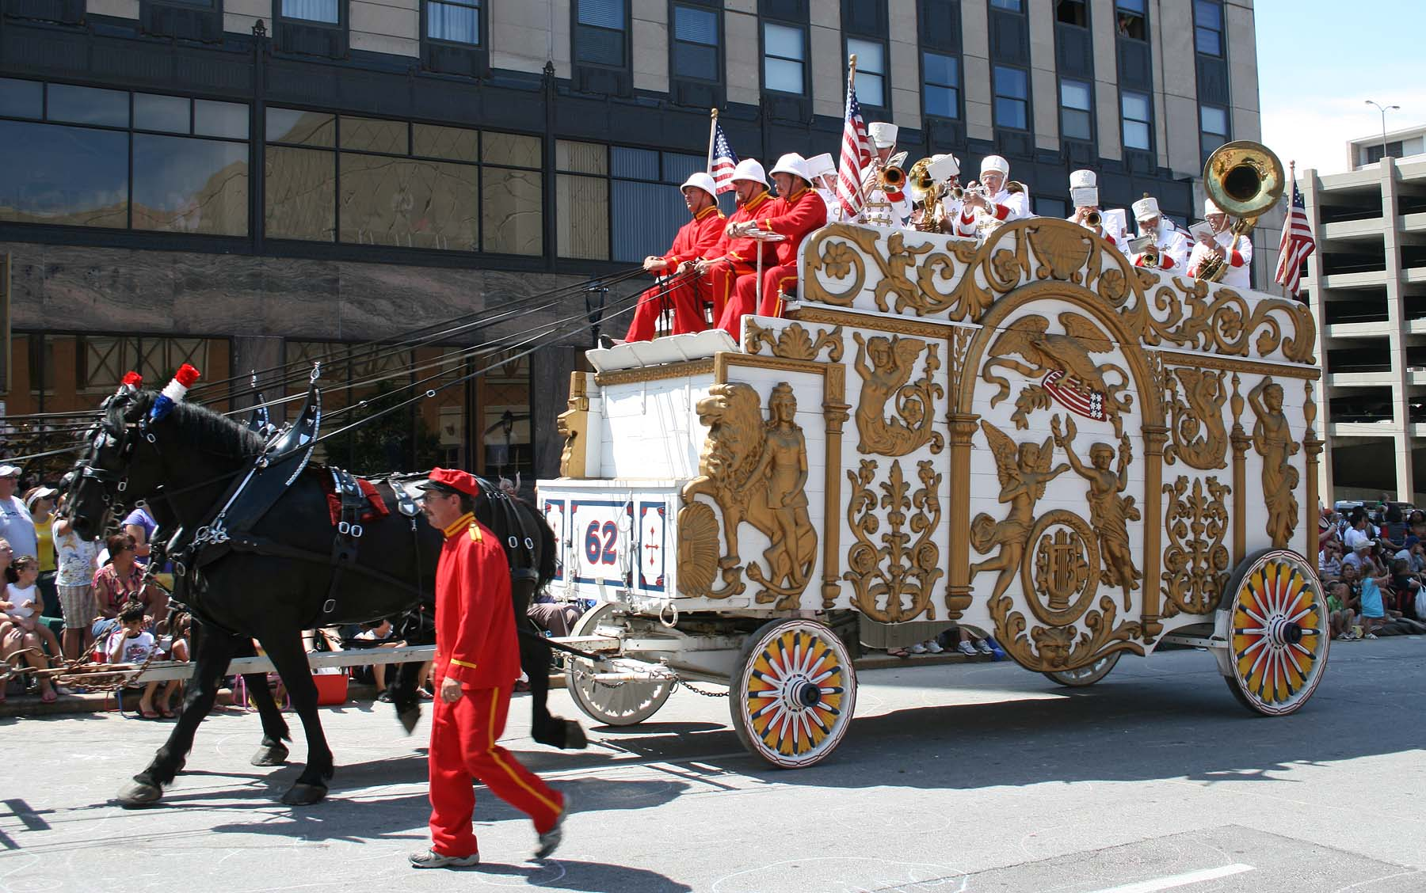
Why TypeScript? – Adoption
15,000+ on GitHub
Over 2 million NPM Downloads
Used by: Microsoft, Angular.js,
Ionic, Telerik, JetBrains,
and many others

Slide 24
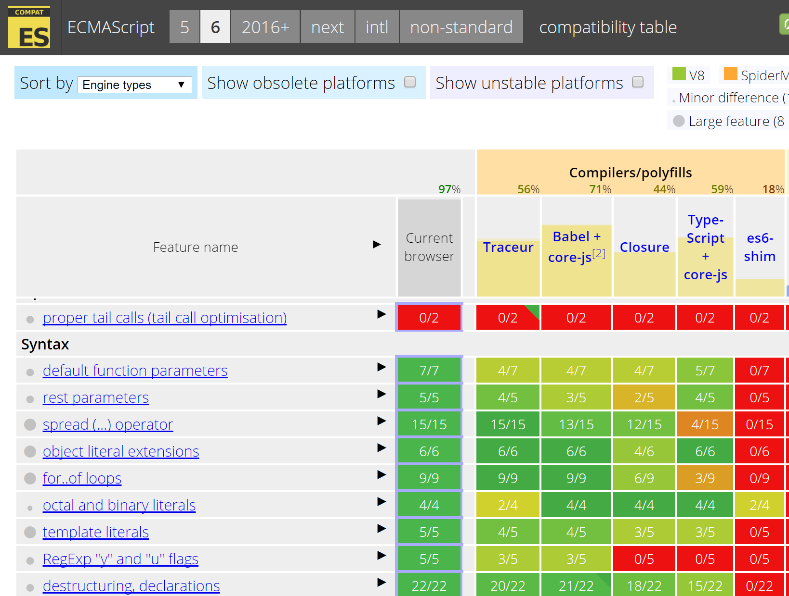
Notes:
http://kangax.github.io/compat-table/es6/

Slide 25
How do I get Started?
TypeScript Playground
TypeScript Handbook
TypeScript Deep Dive

Slide 26
Demos

Slide 27

Major Takeaway
If you’re doing any client side work in .NET, TypeScript is the logical choice.
Website: www.dustinewers.com
LinkedIn: www.linkedin.com/in/dustinewers
Demo Code: github.com/DustinEwers/typescript-demos

